Slide 1
LOGIC POWER SUPPLY
Submitted By: Bibhuti Kumar Sahoo
MBA (2024-26)
IMRT Business School, Lucknow
Dr APJ Abdul Kalam Technical University

Slide 2
Introduction
Logic-Level Power Supply in Electronics
In digital electronics, a logic power supply typically refers to the voltage source that powers logic circuits—like microcontrollers, processors, and digital ICs.
Key Characteristic:
Voltage Levels: Common logic voltages include 5V, 3.3V, and 1.8V, depending on the technology (TTL, CMOS, etc.).
Purpose: Supplies stable DC voltage to ensure reliable operation of digital components.
Example: A 5V regulator powering an Arduino board.

Slide 3
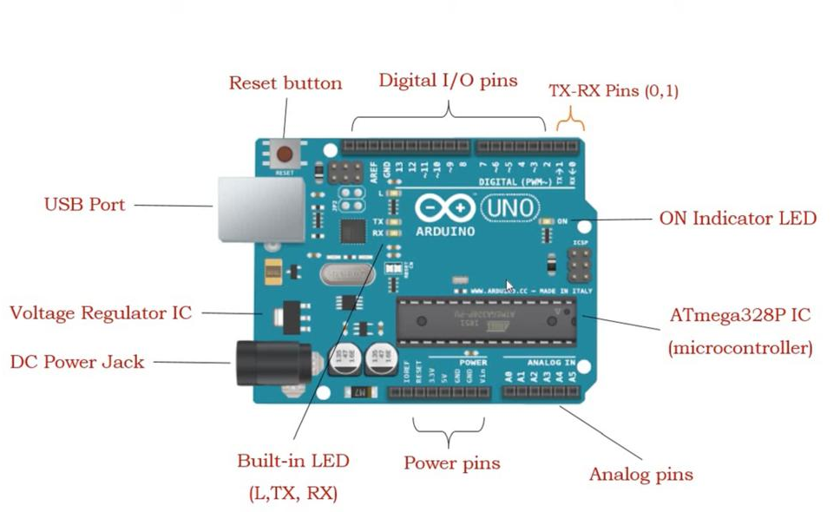
Arduino UNO

Slide 4
Basic Components & Its Purpose
Component | Purpose
Transformer | Steps down high-voltage AC (e.g., 230V) to a lower AC voltage (e.g., 12V)
Bridge Rectifier | Converts AC to pulsating DC using four diodes
Filter Capacitor | Smooths out ripples in the DC output from the rectifier
Voltage Regulator | Maintains a constant DC output (e.g., 5V or 3.3V) despite input variations
Heat Sink (optional) | Dissipates heat from the voltage regulator if current is high
Protection Diodes (optional) | Prevents reverse polarity damage to sensitive components
Indicator LED + Resistor (optional) | Shows power status visually

Slide 5
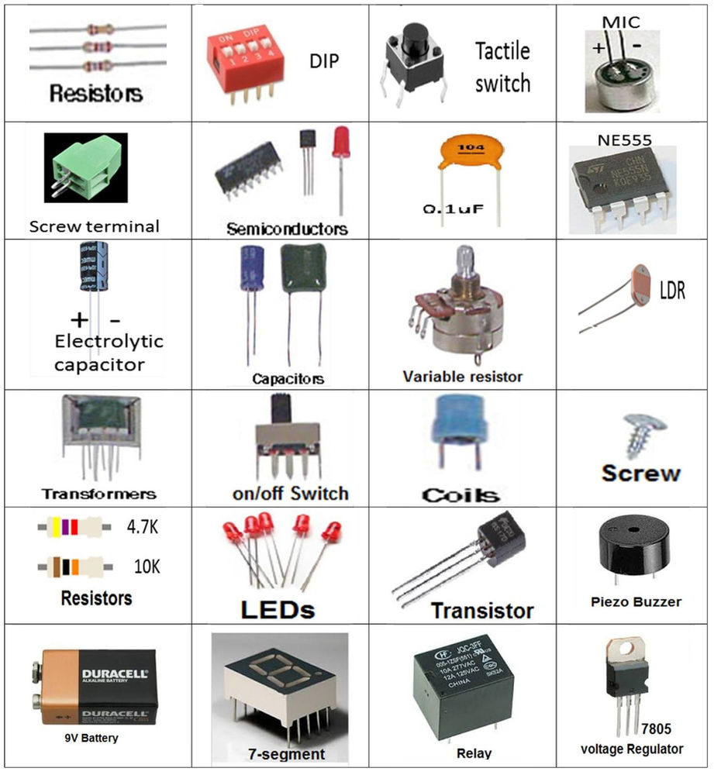
Basic Components

Slide 6
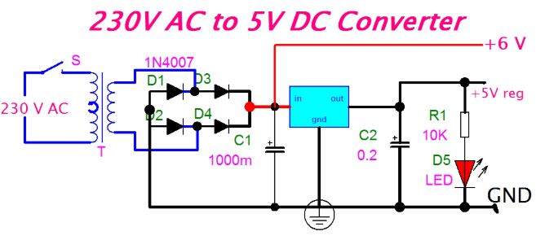
BLOCK DIAGRAM 230V AC to 5V DC

Slide 7
DUAL POWER SUPPLY & COMPONENTS
A dual power supply provides both positive and negative DC voltages with respect to a common ground—essential for analog circuits like operational amplifiers, audio amplifiers, and instrumentation systems
Component | Function
Step-Down Transformer | Converts high-voltage AC (e.g., 230V) to lower AC (e.g., 15V-0-15V center-tap)
Bridge Rectifier | Converts AC to pulsating DC using four diodes or an integrated module
Filter Capacitors | Smooth out ripples in the DC output for stable voltage
Voltage Regulators | Maintain fixed or adjustable output voltages (e.g., ±12V, ±15V)
Heat Sinks (optional) | Dissipate heat from regulators during high current operation
Indicator LEDs + Resistors (optional) | Show power status for each rail (positive and negative)
Bypass Capacitors (optional) | Improve transient response and reduce noise near regulators

Slide 8
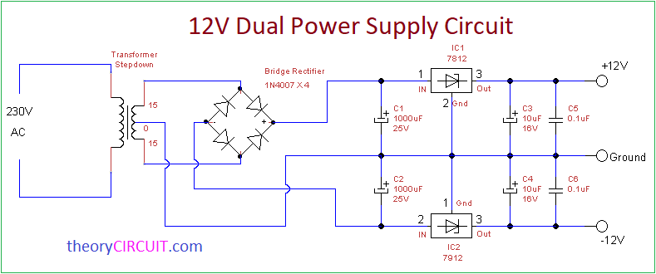
BLOCK DIAGRAM

Slide 9
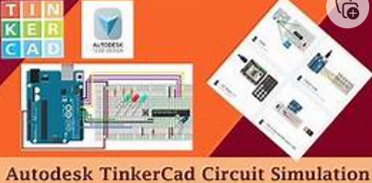
TINKERCAD
TINKERCAD is a free, browser-based simulation tool developed by Autodesk that allows users to design and test electronic circuits virtually.
Relevance in Circuit Preparation
1. Virtual Simulation Before Physical Prototyping
2. Access to a Wide Range of Components
3. Code Integration with Arduino
4. Educational and Beginner-Friendly
5. Accessible Anywhere, Anytime

Slide 10
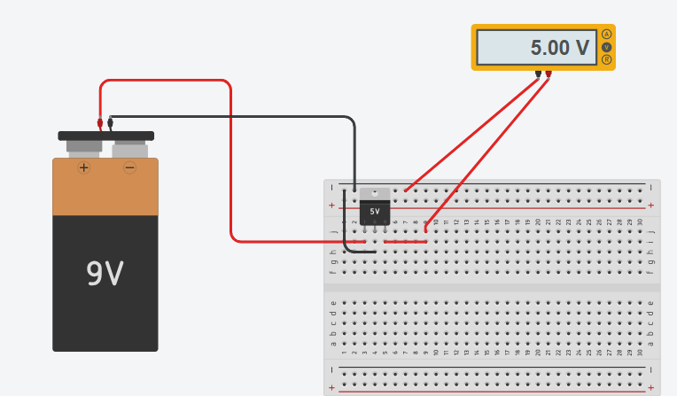
VOLTAGE REGULATOR: SIMULATION

Slide 11
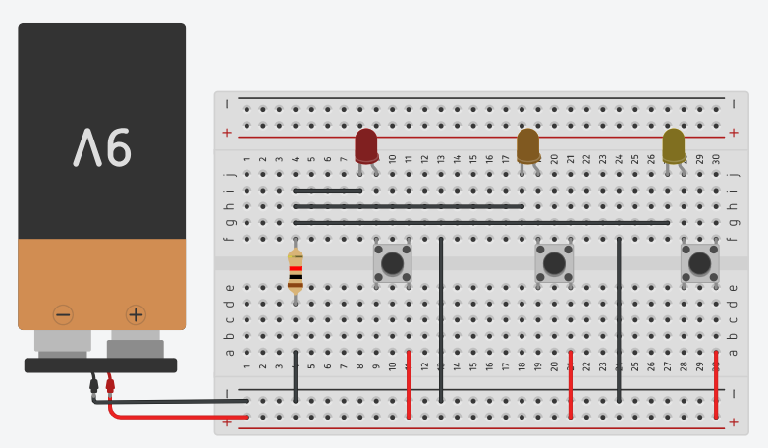
LOGIC POWER SUPPLY

Slide 12
BENEFITS OF LOGIC POWER SUPPLY
1. ⚡ Stable Voltage for Digital Circuits
2. 🧠 Supports Precise Logic Operations
3. 🔒 Protects Sensitive Components
4. 🔄 Enables Modular and Scalable Design
5. 🧰 Simplifies Troubleshooting and Testing
Clean, regulated power makes it easier to diagnose circuit issues.
Reduces noise and interference, improving signal integrity during testing.

Slide 13
Thank you

